Slide 1
The challenge in Recruitment and Retention of Teachers
Sofia 21 December 2012
Martin Rømer, European Director - ETUCE

Slide 2
Recruitment and retention
Why are someone becoming a teacher ?
Mainly because he/she like to work with children
The flexibility in the job

Slide 4
Attraction of teachers

Slide 5
Retention / drop out
Why somebody leaving the job as a teacher ?

Slide 6
Teacher retention factors
Social partners involved in policy development to retain teachers?
Yes = 10 countries; No = 11 countries

Slide 7
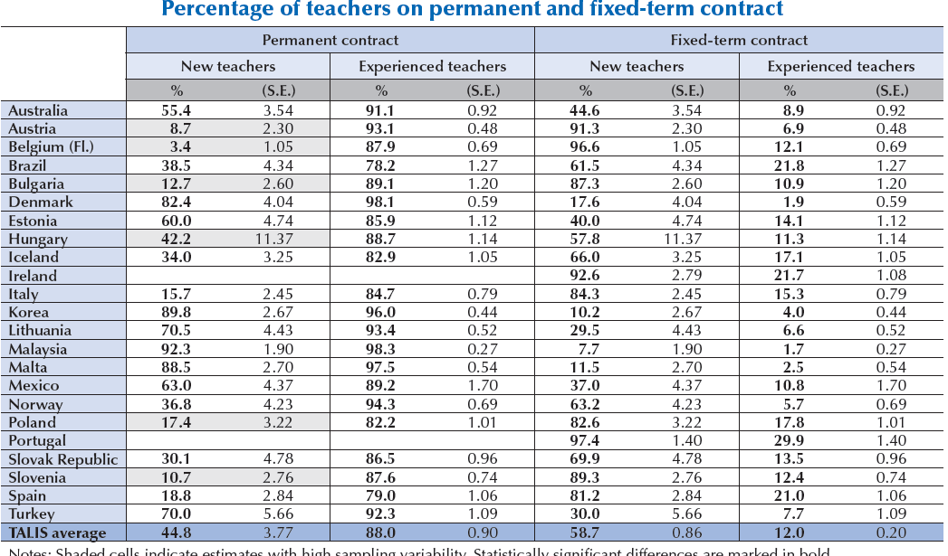

Slide 9
Demographic time bomb
Population decline of 7 % 2001-2011
Fertility rate < 1,5 children
Mortality rate 15/1000
Birth rate 10/1000
1/3 of all pregnancies are aborted

Slide 10
> age 15 : 14 %
< age 60: 25 %
Working people 1/3 less of people retired already
Today's age 30-40 double of age 10-20

Slide 11
Decrease of population
Imbalance between old and young
Less need for teachers
Less young in production
Pressure on public finances
Less income/
pension etc

Slide 12
Key challenges & opportunities
Teacher shortages: ageing population (projected shortages), gender balance, subject-specific teachers
(Young) teachers leaving profession early on/attraction: low salaries, working conditions, career perspective & status, stress
Crisis – delivery quality public services: austerity measures in public sectors, limited collective bargaining, frozen salaries, unfilled vacancies
Initiatives to develop well-qualified teachers: (i) setting standards for education level & training (Master); training relevant to subject needs (e.g. math, science, ICT
Recruiting ‘highest’ qualified (prospective) teachers
Continued professional development
Mobility (recognised recruitment) between sectors, countries, states
Developing social dialogue

Slide 13
Especially young teachers
Best qualified
Practise during Study – getting expectations right
Induction period
Continuous peer support
Adequate salary
Job security
Stress
Early unionising

Slide 14
Thank you
www.csee-etuce.org

